Slide 1

CPU SCHEDULING OPERATING SYSTEM
Ali Hasan kazmi/ FA19-BSCS-0003

Slide 2



WHAT IS CPU SCHEDULING?
Way of Selecting a process from ready queue and
putting it into the CPU
Ready queue in RAM is in which processes
are ready to be executed

Slide 3
PRE-EMPTIVE
NON PRE-EMPTIVE
A process from ready queue is put into the CPU to be executed
And can be put back to the ready queue to be executed later
Reasons can be time slice, priority, shortest process first etc.
A process from ready queue is put into the CPU to be executed
Process will completely be executed taking its actual burst time

Slide 4
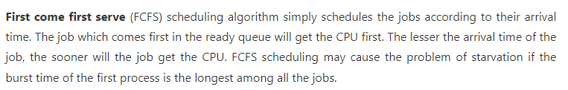
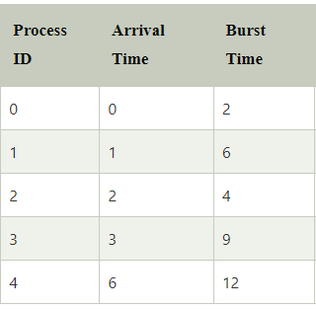
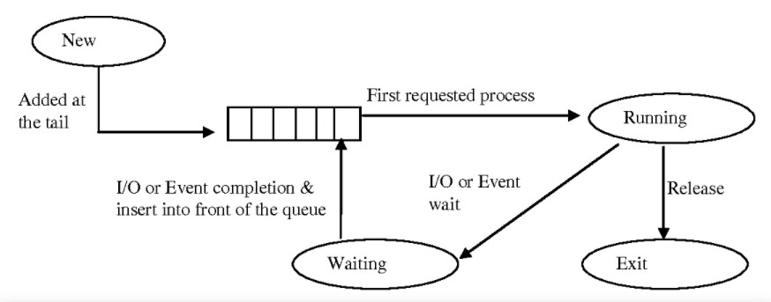

FIRST COME FIRST SERVE [non pre emptive]

Slide 5
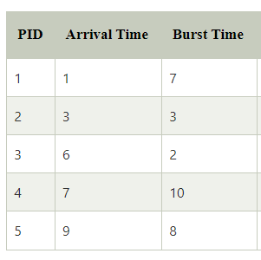
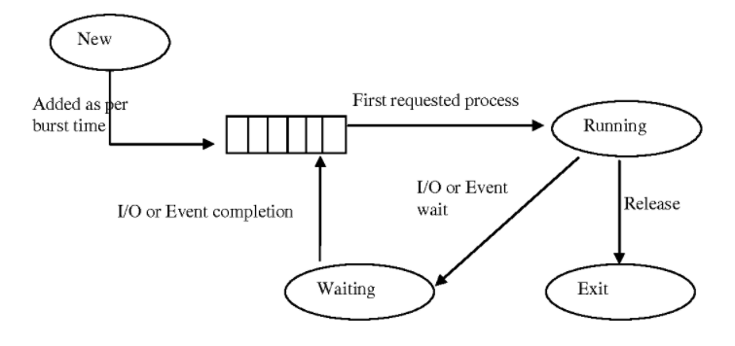
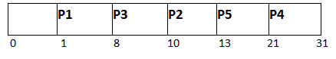
SHORTEST Job first [non pre emptive]

Slide 6
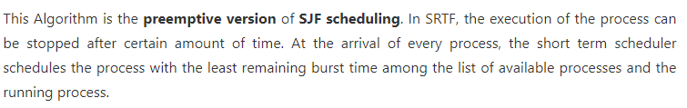
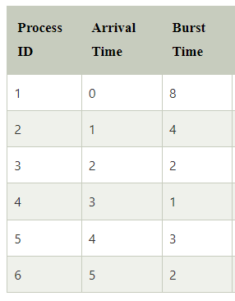
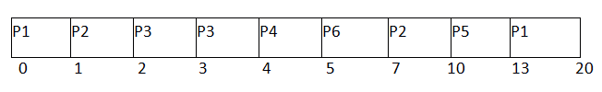
SHORTEST REMAINING TIME FIRST [pre emptive]

Slide 7

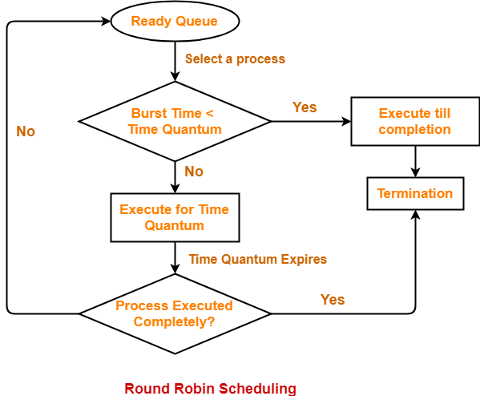
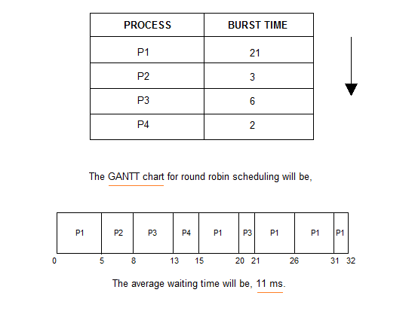
ROUND robin [pre-emptive]

Slide 8
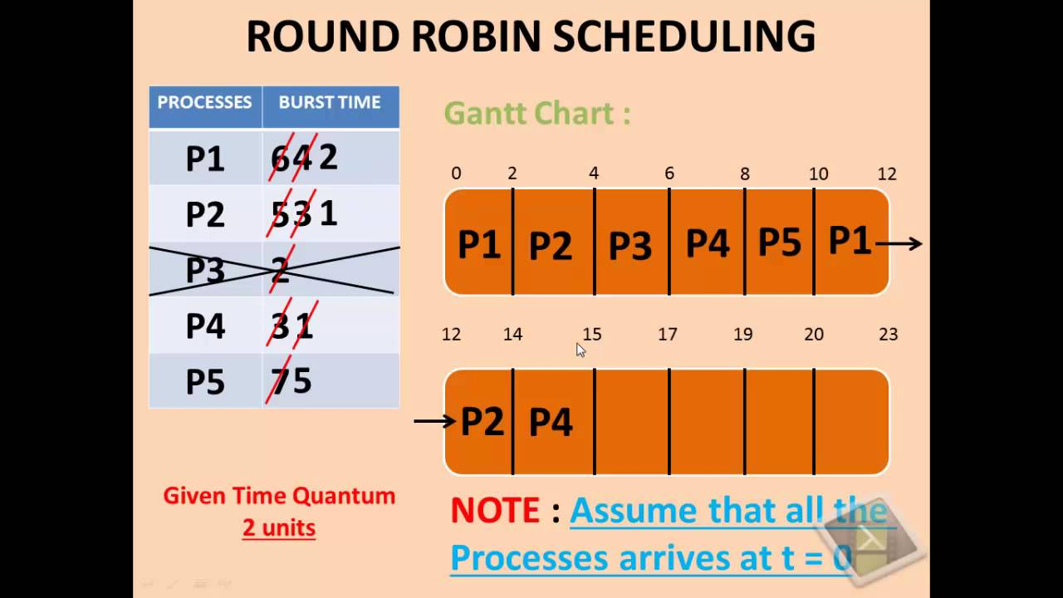

Slide 9
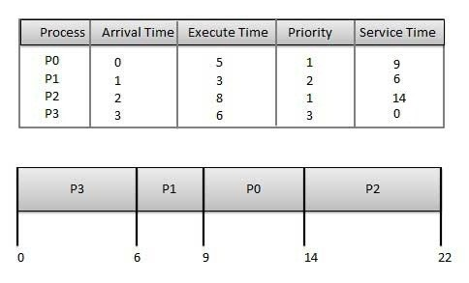
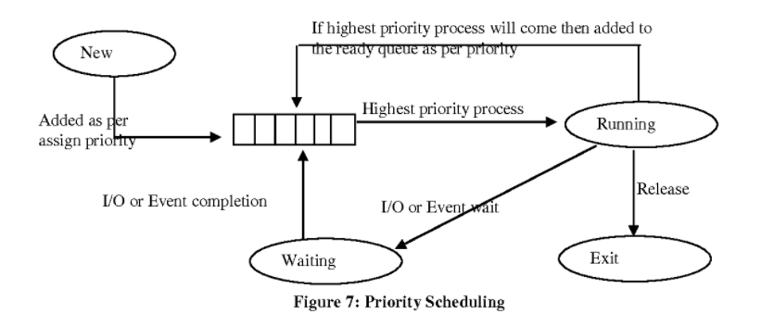
PRIORITY scheduling

Slide 10
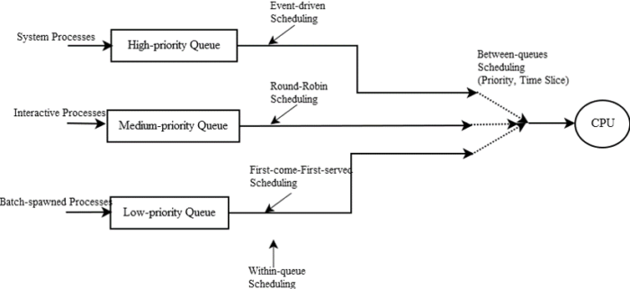
Multi level scheduling

Slide 11

Thank You!
ALI HASAN KAMZI/ FA19-bscs-0003

